Slide 1
Building Respect and Inclusion in Astronomy: Strategies for Addressing and Overcoming Harassment
Presentation by
Sheryl Bruff and Bernice Durand
January 10, 2011

Slide 2
Why should we care?
Great science and discovery are enabled by an open climate where individuals are free to share knowledge, opinions, beliefs and ideas.
This cannot and will not happen if a segment(s) of the practitioners are disenfranchised and disrespected.
The composition of the astronomical community has and will continue to change.
We see ongoing efforts to broaden participation in astronomy, particularly for women and under-represented minorities.
It will be necessary to fully engage these constituencies by creating a climate of inclusion, respect and openness.

Slide 3
Harassment is pervasive
Since problem was first recognized on college campuses in the early 1980s, the frequency of complaints has increased.
While all members of the academic community are potential victims of unwelcome sexual behavior, a majority of the complainants are female students, faculty and staff.
Over 60% of undergraduate women and men report they have experienced sexual harassment
20-30% of undergraduate female students report that they have been victims of some form of sexual harassment by at least one of their professors. When this was expanded to include sexist remarks, the number rose to 75%.
(Dziech and Weiner, 1984)
(AAUW 2006)

Slide 4
Thank you to
Dara Norman, NOAO, session organizer
CSWA and CSMA for co-sponsorship
AAS for its
anti-harassment policy
commitment to leadership in developing “people” skills
desire to identify and disseminate best practices and tools
Anti-Harassment Policy for Meetings and Activities of the American Astronomical Society and Divisions

Slide 5
What is harassment?
Simple Question -- Complex Answer

Slide 6
A pattern of abusive and/or degrading conduct, or a single incident of extreme behavior, directed against an individual(s) on the basis of his or her sexuality or membership in a protected class.

Slide 7
Unwelcome verbal, visual or physical conduct of a nature that is severe and/or pervasive and adversely affects working conditions or creates a hostile work environment.

Slide 8
Types of Harassment
“Quid pro quo” (“this for that”) harassment
Reported less frequently
Only includes sex
Tangible Action
Affects hiring, salary, promotion, work assignment, …
Hostile Work Environment
Based on sex, gender, race, etc.

Slide 9
Protected Class
Harassment requires membership in a protected class
May be based on sex, gender (membership in class rather than sexual in nature), race, age, national origin, religion, disability, marital status
Protected classes can vary by state and local jurisdiction – physical qualities, sexual orientation and/or identification, health, etc.

Slide 10
Key Concepts
Form of discrimination
Form of bullying
Persistent
Unwelcome
Intolerable
Severe and/or Pervasive
Generally an isolated comment or action will not rise to harassment unless significantly egregious
A number of relatively minor incidents may add up to harassment
Perceived power of one individual over another can “set the stage”

Slide 11
V Verbal or Written
V Verbal or Written
Jokes – sexual, racial, religion . . .
Disparaging comments – about work, membership in protected class, etc.
Comments about clothing, personal behavior or a person’s body
Rumors
Threats
Emails, blogs, etc.
Poor interpersonal skills

Slide 12
Visual
Posters
Drawings
Pictures
Screensavers
Emails
Looks or gestures

Slide 13
Physical
Assault
Impeding or blocking movement
Inappropriate touching of a person, person’s clothing
Kissing
Hugging
Patting
Stroking
Oblivion to personal space customs

Slide 14
Bullying vs. Harassment
Similar behavior applied to individuals regardless of gender, race, etc.
Bullying behavior has not been dealt with by courts.
Growing interest in the affects of bullying
Could still have exposure in tort law
Organizations should develop expectations, policies, processes, etc. to address bullying.

Slide 15
Impacts of Harassment Individually and Organizationally
Loss of productivity
Poor work performance
Limits open discussion, ideas, creativity, research and discovery
Adverse physical and mental impacts
Reputational Risk
Exit from profession
Lawsuits
Loss of federal grant funds

Slide 16
If It Happens To You
Speak up. Do not remain silent.
Object to harasser, if possible, either verbally or in writing.
Consultation is NOT escalation!!
Keep documentation and records.
Identify and try to gather information from those who witness or also have been affected by this behavior.
Consult the web for whom to contact.
If all else fails, report to HR, or the Dean of Students.
Absolute confidentiality cannot always be guaranteed.

Slide 17
“Conditional Confidentiality”
Absolute confidentiality cannot always be guaranteed.
The nature of the offense may mandate action.

Slide 18
What To Expect From Your Institution
Leadership from the top
Highly-positioned SH response officer; possibly network of knowledgeable contact people
Well-advertised policies, such as posters on sexual harassment in all workplace and classroom buildings, and good web site.
Sexual Harassment Information Sessions (SHIS) for employees. This is in the interest of institution (legal liability)

Slide 19
Institutional Action STScI
Director initiates some and backs all policies on fair treatment as well as family- and female- friendly policies
HR Director in charge of trainings, investigations, discipline – backed up by Director – (“call Sheryl”)
Training
Posters
Website – policies and procedures

Slide 20
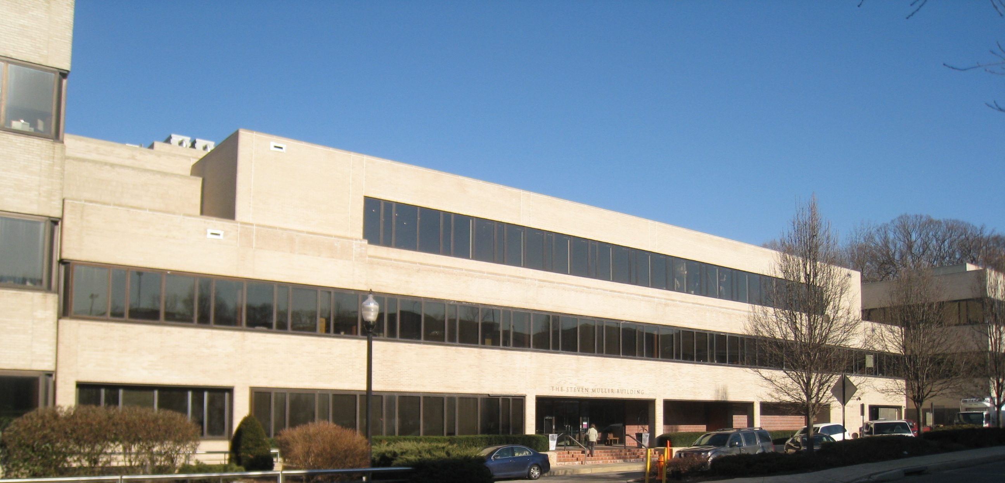
sustaining excellence through a competitive energetic
vocal and motivated staff is critical to the vitality of STScI
it is how that competition of ideas is waged and
how diverse the constituency that feels empowered
to participate in that debate, which is at the core of
transforming STScI into a 21st Century organization

Slide 21
Institutional Action UW - Madison
Leadership: Provost mandates Sexual Harassment Information Sessions for all “limited” appointees; deans/directors mandate for employees, including TAs, PAs.
Training led by Provost’s Office and Office for Equity and Diversity (OED).
Director of OED is the top “go-to” person (“call Luis!”). Had broad network of contact people; shorter list improved consistency, includes 6 of deans of students.
Non-Discrimination Poster at Office for Equity and Diversity,
web site: Sexual Harassment Information and Resources

Slide 23
OED Web Site Index …
What is Sexual harassment?
Tangible Action or Quid Pro Quo Harassment
Hostile Environment
What to do about sexual harassment?
Expectations (if you feel you’ve been sexually harassed; if you are accused of inappropriate behavior; if you are in a position of authority; if you are a colleague or peer)
Advice for conversations
Protection from retaliation ←note
Consequences of sexual harassment and legal liability

Slide 24
… OED Web Site Index
Campus policies
Prohibited Harassment Policy
Consensual Relationship Policy ← note
Sexual Harassment Policy for Classified Employees
Campus resources
Informational sessions ← Focus on this
Goals & Outcomes
Case Studies ←
Vignettes (What's a Person to do?) ←
Campus Safety (switches to student site)
Safety and Sexual Assault

Slide 25
How about your institution?

Slide 26
Case Studies:
Watch out for “it depends.”

Slide 27
Information Sessions Case studies for discussion
Case One
Two students who work part-time in an office on campus are having trouble getting along in the office. Their supervisor interviews each of them. Both report that they used to be great friends and often went out for beer together after work.
The male student asserts that the tension resulted from his rejection of the female student's sexual advances. He claims that ever since he rejected her, she has said nasty personal things to him and about him to other members of the office staff, creating a hostile work environment.
The female student says that the tension resulted from the male student's condescending attitude and disrespect for her work. She claims that the other student belittles her and denigrates everything she does in the office.

Slide 28
Information Sessions Case studies for discussion
Case One: Discussion Questions
Put yourself in the position of the supervisor.
What might happen if you do nothing?
What could happen if you leave it to the two students to work out?
What should you do next?

Slide 29
Information Sessions Case studies for discussion
Case Two
A professor and a research associate employed by the professor attend a professional meeting out of town and have a one-night sexual encounter. Both are in long-term relationships and agree that the affair will not continue when they return to campus.

Slide 30
Information Sessions Case studies for discussion
Case Two: Discussion Questions
Imagine you are the professor.
What should you do next? Why?
What if word of the event spreads throughout the lab and other members of the group complain that the research associate is getting preferential treatment?
What if, six months later, you decide to terminate the research associate's position?

Slide 31
Information Sessions “WHAT’S A PERSON TO DO?”
Groups of three – select one case to discuss.
Discussion:
Is this harassment?
Who, if anyone, is in the wrong?
What should the recipient of the behavior, or the person consulted, do?

Slide 32
What Will It Take? …
We need to “GET IT”. Hostile Work Environment can be hard to define as it is often in the eye of the beholder:
“But s/he should understand how I am… my culture … my style …”
It is about the audience, not the actor.
“That’s the way things are.”
Privilege and Power are often based on unconscious schemas/ biases of the dominant group. Creates a “blind spot”.
“That’s not what I meant!”
Does not matter what was meant, matters what was heard/experienced/perceived. “Unintentional” defense in hostile work environment claims often is the result of unknown, unquestioned or unevaluated schemas and biases.
“She’s a trouble maker.” “It can’t be true or she would not have put up with it.” “He’s playing the _____ card to avoid responsibility.”
People who bring claims are often disbelieved. The motives of the complainant are mistrusted.

Slide 33
… What Will It Take?
Develop, distribute, enforce, and conduct briefings on policies.
Train everyone on what constitutes prohibited behavior and what gives rise to harassment
“Reasonable Woman” Test
Create shared understanding of what is/isn’t acceptable
Encourage examination and discussion of attitudes and behaviors towards others. Question biases and schemas
Open communication – speak up.
Ensure consistent response, action and consequences.
Understand rights and responsibilities – both those it happens to and those that see it happening.

Slide 34
General Background Information

Slide 35
AAUW Study
In a more recent study on sexual harassment at colleges and universities, the AAUW claimed that while both men and women were targets of sexual harassment, "women are disproportionately negatively affected.“
62% of female college students and 61% of male college students report having been sexually harassed at their university.
66% of college students know someone personally who was harassed.
10% or fewer of student sexual harassment victims attempt to report their experiences to a university employee.
35% or more of college students who experience sexual harassment do not tell anyone about their experiences.
80% of students who experienced sexual harassment report being harassed by another student or former student.
39% of students who experienced sexual harassment say the incident or incidents occurred in the dorm.
51% of male college students admit to sexually harassing someone in college, with 22% admitting to harassing someone often or occasionally.
31% of female college students admit to harassing someone in college.
(AAUW 2006)

Slide 36
History of Harassment Law
Title VII of the Civil Rights Act of 1964
Title IX of the Higher Education Amendments of 1972
ADEA
ADA
Case law
Meritor Savings Bank v. Vinson,
Burlington Industries, Inc. v. Ellerth
Faragher v. City of Boca Raton
Anita Hill – Clarence Thomas Confirmation Hearings
Highlighted aspects and complexities of hostile work environment

Slide 37
Legal Aspects
Harassment generally must result in:
A “tangible employment action; e.g., hiring, pay, promotion, references, work assignments, etc. , or
Hostile Work Environment – unreasonable interference with an individual’s work performance – intimidating or offensive working environment.
Who is considered liable?
“Employers”
Organizations
Individuals
EEOC has jurisdiction. However, cases can go immediately to lawsuit.
Litigation can include actions in tort law – intentional infliction of emotional distress, libel, slander, defamation.
Liability for harassment by third parties.
Retaliation
Taking adverse action against someone for making a good faith claim or for cooperating in an investigation
Considered more egregious than initial act.
Where harassment can sometimes be defended as “unintentional”, there is no defense to retaliation and many organizations view it as a dismissible event.

Slide 38
Investigation
If a claim is made – personally or organizationally – there is a legal and ethical responsibility to report, investigate and act
Not permitted to “keep off the record”
This should be disclosed to the individual making a claim
Investigations are generally discreet , but absolute confidentiality cannot always be guaranteed
Can be helpful to create summary investigatory document containing:
summary of claim
expectations for investigation and outcome
timeframe
initial list of interviewees/witnesses
protections against retaliation
Be sure to provide claimant with outcome of investigation – not necessarily details of disciplinary actions, if taken
Identify and consistently utilize appropriate sanctions and remedies if a claim is substantiated

Slide 39
TO RECEIVE THIS POWERPOINT
Email one of us: Sheryl Bruff bruff@stsci.edu
Bernice Durand bdurand@wisc.edu

