Slide 1
The AAS Working Group on Accessibility and Disability (WGAD): progress, current projects, and prospects for making astronomy accessible to all
Alicia Aarnio, Wanda Díaz-Merced,
Jacqueline Monkiewicz, and Karen Knierman
wgad.aas.org
Notes:
Representation of astronomers with disabilities is low at the earliest career stages and losses compound with career stage thereafter; single-digit and lower percentage representation statistics are in large part due to systemic barriers to access and failure to accommodate the needs of users of a wide range of abilities. In this presentation, we discuss the barriers currently inhibiting broad access to astronomical publications, databases, and conferences. The WGAD was formed in January of 2016 to work toward removal of these barriers to make our field inclusive of astronomers with disabilities at all career stages. We have productively engaged with publishers and accessibility audits have been performed. Database accessibility evaluation is underway, and we are working with the AAS and other professional organizations on conference accessibility. We are keeping users centrally focused via surveys and user test groups, and holding paramount the overarching idea that meeting present accessibility standards is a necessary but insufficient condition for full access.

Slide 2
Access Note:
Please use this space as you need or prefer.
Sit in chairs or on the floor, pace, lie on the floor, rock, flap, spin, move around, knit, step in and out of the room.
Feel free to use your laptop or your electronic devices or your mechanical fidget devices if you brought them. Take notes or play video games.
Meeting tag #aas231; us: @AAS_WGAD, @AliciaAarnio, @jmonkiew
Please use headphones if you use audio. -adapted from Lydia Brown, @autistichoya

Slide 3
Accessibility and disability
Disability is defined as any mental, cognitive, or physical condition that, due to society’s structure, results in a significant barrier to engaging with society. Disabilities may be invisible or visible, and diagnosed or undiagnosed.
Everyone’s ability changes with time, and universal design benefits everyone.

Slide 4
Accessibility and disability
WGAD approaches initiatives within a mixture of the social and nordic models of disability:
We acknowledge that social and environmental barriers constitute a major problem for many disabled individuals in the field; addressing these is a priority in the AAS.
Disabled peoples should have choices over our lives, and the field of astronomy should support disabled peoples to perform and participate as equals in the professional community.
The persistent assumption that in sciences disabled people are defined by our “incapacity to perform certain tasks abled people do” is a cultural barrier in our professional field that must be challenged.
WGAD observes users to understand how we people with disabilities experience barriers to our science, and how we experience our impairments in our science
This serves to acknowledge experiences, and
Contributes both quantitatively and qualitatively to the field of astronomy and disability studies.

Slide 5
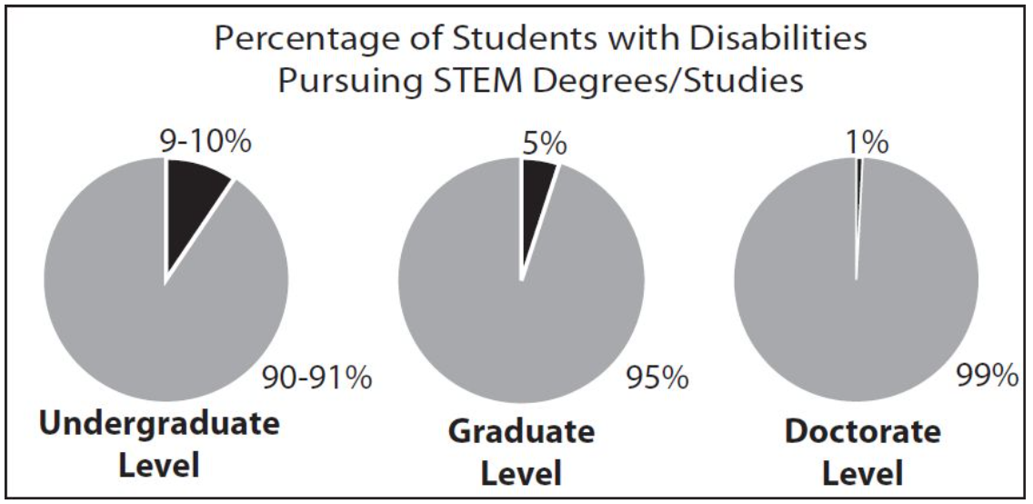
Astronomers and STEM researchers with disabilities

Slide 6
Formation of WGAD
Approved by AAS in January 2016, WGAD is tasked with promoting inclusion of and equity of opportunity for disabled astronomers at all career stages.
WGAD is working to:
Identify, document, and eliminate the barriers to access (including access to information) that impact disabled astronomers and students;
Actively address the intersections of ableism with racism, sexism, heterosexism, cissexism, and classism;
Increase accessibility for disabled astronomers and students;
Support the current professional astronomy community to bring people with disabilities into the workforce;

Slide 7
Formation of WGAD
WGAD is working to: (cont’d)
Recognize disability by teaching disability history, specifically including the disability history of astronomy;
Work to discourage the erasure of disability in astronomy;
Promote knowledge of the roots of ableism and its effects in our classrooms and workplaces to change it;
Change the culture within astronomy to remove the stigma associated with disability and to value accessibility as a human right;
Promote the development and use of access tools and software; and
Build community among disabled astronomers and students.

Slide 8
Barriers to access and engagement
Notes:
There are many, but here we highlight 3 specific ones we’re working on

Slide 9
Publication access
Submission of new manuscripts
Accessing (often, older) scanned manuscripts
Navigation of HTML and PDF manuscripts
Content organization and clarity
Visibility of chosen color schemes
Captioning of figures
Engaging with data tables and equations
Is the submission and retrieval process possible with an assistive technology device?

Slide 10
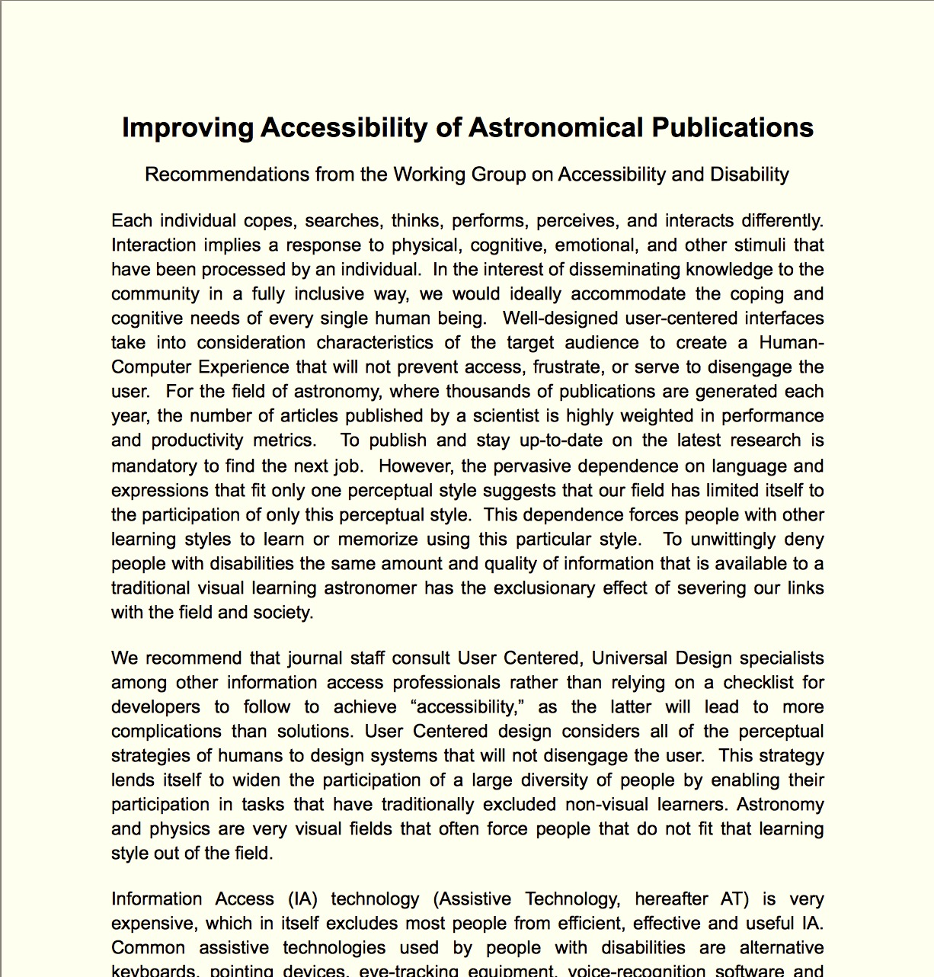
Publication access recommendations
Fall 2016: sent publication accessibility recommendations to AAS Publishing, IOP
January 2017: met at winter meeting to discuss audits, progress timetable
Focuses on what publishers and authors can do to remove barriers
Copies available at our display in the AAS booth
(Exhibit Hall) and at wgad.aas.org

Slide 11
Publication access recommendations
For publishers:
Accessible user interface: navigable, alt-text, no small clickable elements
Standardized format across journals
Survey users on accessibility
Test for screen-reader compatibility
Provide guidelines and ask referees to comment on a manuscript’s accessibility
For authors:
Use colorblind-intuitive palettes for figures
Be clear in organization of ideas
Provide detailed, descriptive figure and table captions
Notes:
A few examples

Slide 12
Databases
Includes both bibliographic and observational databases
Inconsistency of access, formatting across databases
Tabular navigation and selection
Inscrutable, difficult to remember filenames
Single file formats offered, inflexibility in data manipulation
Can data be obtained without clicking on small, toggle elements? Can tables of query results be easily tab-navigated?

Slide 13
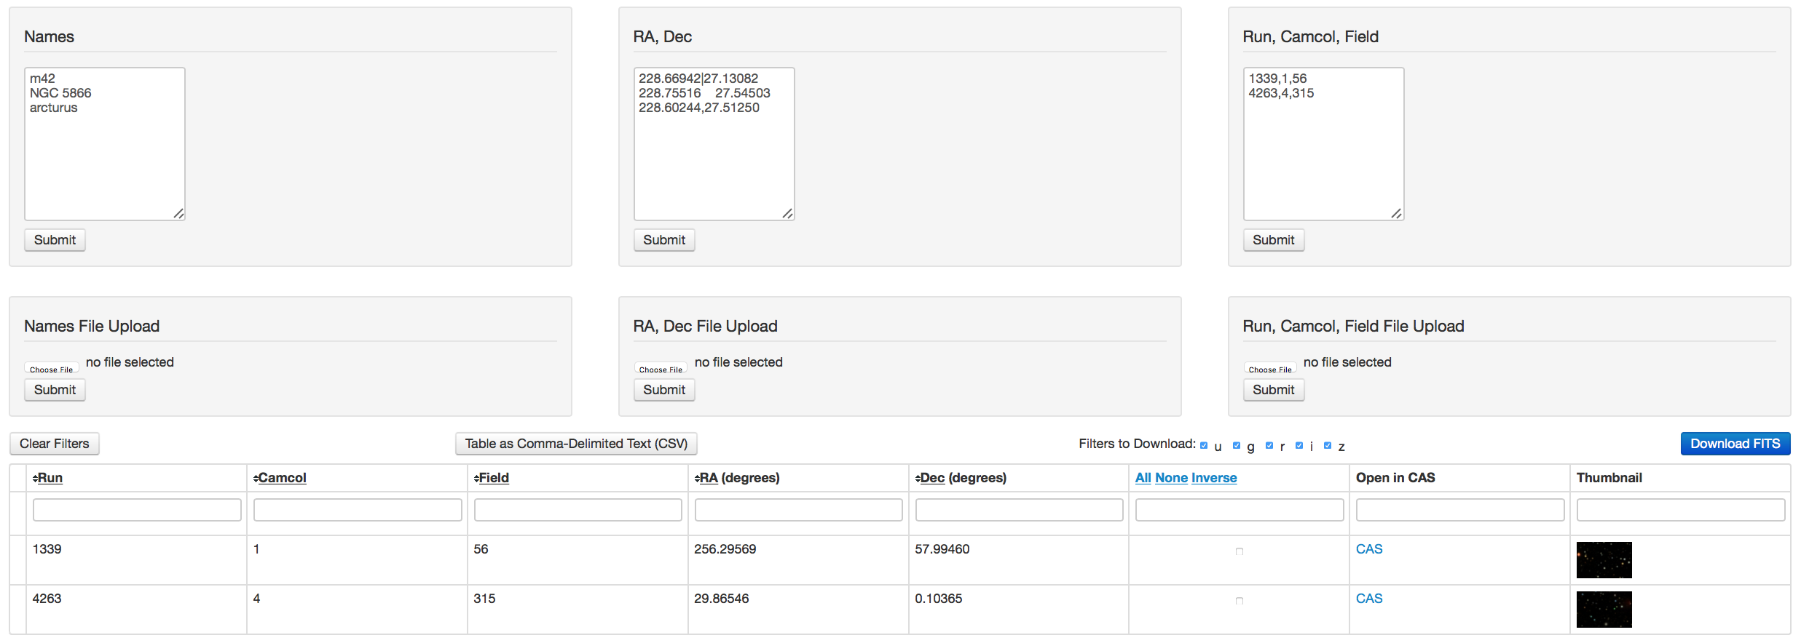
Database access recommendations
Document and code in partnership with IAU Commission C1 WG Astronomy for Equity and Inclusion, Office for Astronomy and Development
We recommend
New databases be designed with user-centered universal design
Open-ended development for interfacing with assistive tools (e.g., xSonify)
Testing capability to evaluate user experience should be baked-in to current and new databases

Slide 14
Conferences
Inconsistent microphone usage
Distance/time problems: big venue, short schedule allowances for transition
Chairs at posters, for speakers
Single-modal access
Unlabeled foods
Service animal access
Traffic flow issues
Font sizes, visibility of screens
Can the venue be navigated easily by all and are presentations accessible? Is there equitable opportunity for engagement?

Slide 15
Conference access recommendations
Document in progress! Lead: J. Monkiewicz
AAS is receptive and supportive of our efforts-this meeting’s site outlines access provisions and acknowledges accessibility work in progress: https://aas.org/meetings/aas231/accessibility
Broadly, meeting access includes accessibility of:
Spaces: can people of varying mobility get where they want to go?
Content: microphones, audio feeds for assistive devices, and screens for presentations, captioning/ASL
Engagement: large fonts on name badges (thank you, AAS!!), inclusive behavior, accessible networking events
See poster in AAS booth, Monkiewicz et al.: “Accessibility Guidelines for Astronomy and Astrophysics Meetings”

Slide 16
Overall take-aways
Barriers to access exist in Astronomy; these lead to underrepresentation and marginalization of Astronomers with disabilities
We are working on publication, database, and conference accessibility
Universal design: if we build it, they will come. Accessibility helps everyone
User-centered design: meet users where they are, build systems that will meet their needs. Give users options for how they can interact with information, ability to manipulate as needed
Small numbers mean less feedback to build on, we need the community’s help: feedback and focus group testing
We are working to simultaneously apply patches (we’re losing people now) and shape new infrastructure

Slide 17
WGAD contact info & resources
wgad.aas.org/resources
Our recommendations documents
Links to sites with tips for making your documents, presentations, classes more accessible
wgad.aas.org/contact
Working group coordinating committee members, emails
Comment form
@AAS_WGAD
bit.ly/AccessAAS231
bit.ly/JournalAccessAAS231

